Slide 1

Introduction to Machine Learning
Today’s Agenda
What is Machine Learning?
Categories of ML: Supervised, Unsupervised, Reinforcement
Real-life Applications of ML
Basic Terminologies
Workflow of an ML Project
Hands-On Practice
Kahoot(Quiz)

Slide 2
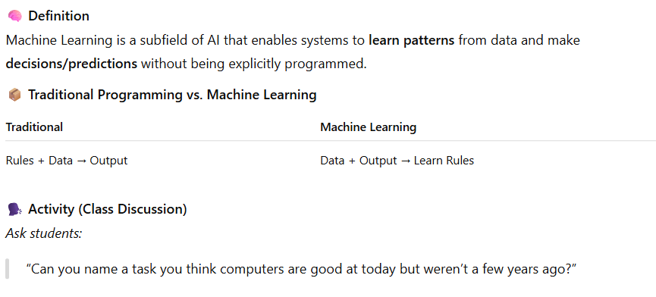
What is Machine Learning?

Slide 3
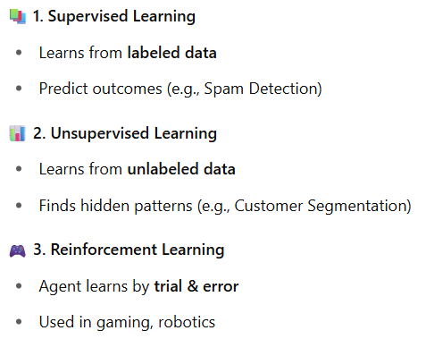

Types of Machine Learning
Unsupervised learning le shape size color ko aadhar ma xuttauxa
Trained hudaina

Slide 4
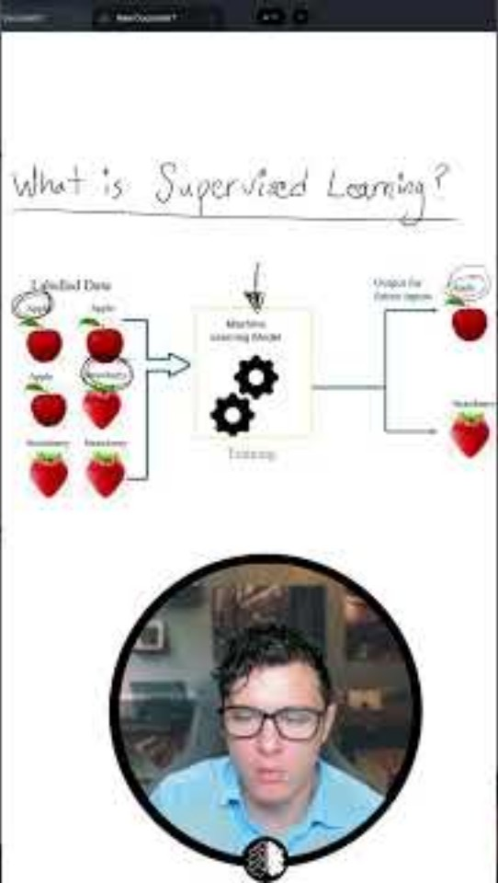

Slide 5
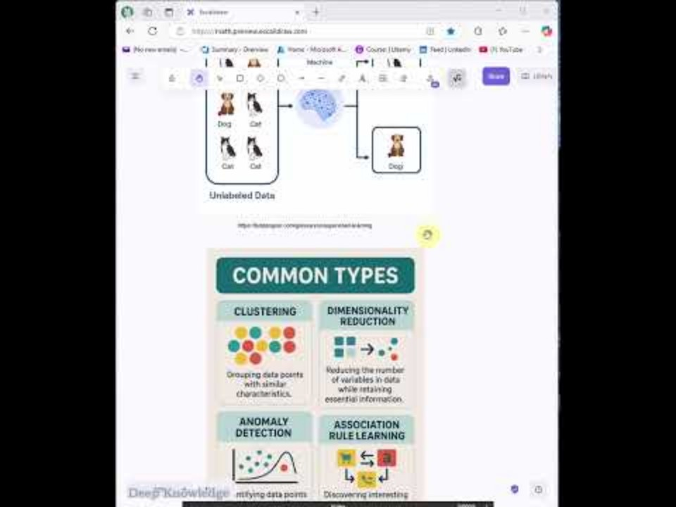

Slide 6
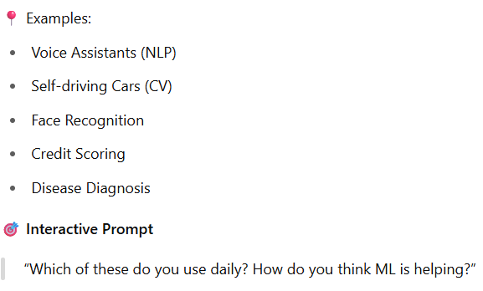

Real-world Applications of ML

Slide 7
Short break

Slide 8
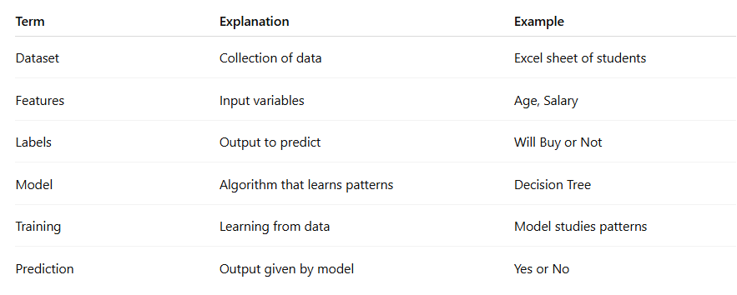
ML Terminologies Simplified

Slide 9
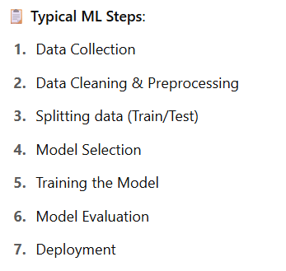
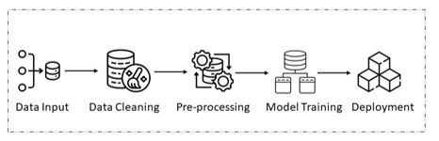
ML Pipeline (Workflow)

Slide 10
Main Break

